Slide 1
WELCOME
TO OUR
PROJECT

Slide 2
Online Electronic Voting System

Slide 3
A project work by______
Tajim Md. Niamat Ullah Akhund; Roll-1916
Priyanka Dhar; Roll-1893
Nazifa Tabassum Mina; Roll-1890
Mahmuda Khan Moon; Roll-1895
Rezoana Akter; Roll-2044

Slide 4

Supervised By
K M Akkas Ali
Associate Professor
Institute of Information Technology
Jahangirnagar University
Savar, Dhaka-1342, Bangladesh
Institute of Information Technology
Jahangirnagar University
September, 2014

Slide 5
Online Electronic Voting System working steps
Admin will add the party, positions, candidate and voters in admin site.
Voter will be registered by admin.
Registered voter can login in user site.
One voter can login and vote only one time.
The candidates of all positions of all parties will appear gradually.
Voter will select the candidates, confirm votes and submit finally.
Admins can see the results, save and print them finally.

Slide 6
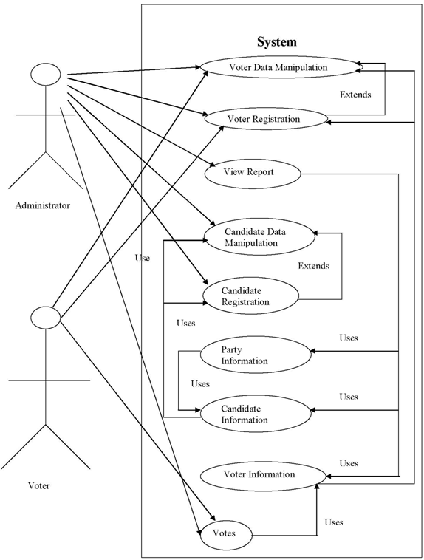
Use case Diagram of Our Project

Slide 7
Let’s See Our Full Project In Both User And Admin Site
Link to user:
http://localhost/electronicvoting/
Link to admin:
http://localhost/electronicvoting/admin/

Slide 8
Importance of this work
The existing system of election is running manually and the using electronic voting machine (EVM) has many limitations in its mechanism.
In this project, we have made an automated online electronic voting system by which voter registration, candidate selection, voting activities and reporting systems are accomplished automatically.
Proper security services are also incorporated in the system to secure the database of the voters’ information, and voter details.
The casted votes will be counted automatically which would take lesser time than the manual system.
The result would be accurate, faster and reliable.
Minimizing corruption.

Slide 9
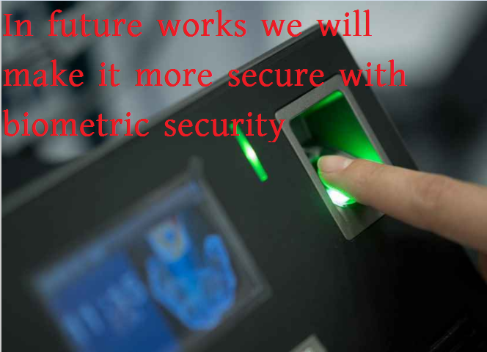
Further application
In future we want to make this system biometrically secure with fingerprints. Biometric electronic voting system is very challenging work. Moreover, fingerprints have been one of the most highly used methods for human recognition; automated biometric systems have only been available in recent years.

Slide 10
Thank
You

